Slide 1
Cloud Computing
Lecture 10

Slide 2
Cloud Computing Concepts
The cloud has five defining characteristics:
On-demand self-service
Broad network access
Resource pooling
Rapid elasticity
Measured service

Slide 3
Service Models
There are four basic models with which clouds provide services:
Software as a Service (SaaS) – applications in the cloud
Platform as a Service (PaaS) – languages and tools to support application development in the cloud
Infrastructure as a Service (IaaS) – processing, storage, network components in the cloud
Cloud computing implies export of processor, storage, applications, or other sources. Sharing resources increase security risks.

Slide 4
Service Models
A private cloud has infrastructure that is operated exclusively by and for the organization that owns it, but cloud management may be contracted out to a third party.
A community cloud is shared by several organizations and is usually intended to accomplish a shared goal.
A public cloud, available to the general cloud, is owned by an organization that sells cloud services.
A hybrid cloud is composed of two or more types of clouds, connected by technology that enables data and applications to be moved around the infrastructure to balance loads among clouds.

Slide 5
Moving to the Cloud
Moving to a cloud can be difficult and expensive, and it can be equally expensive to undo. While every cloud offering presents its own set of risks and benefits, a number of guidelines can help you understand whether your functions and data should be migrated to a cloud environment, as well as which cloud offerings will be most likely to meet your security needs.

Slide 6
Risk Analysis
Risk analysis should be a part of any major security decision, including a move to cloud services.
Identify access.
Determine vulnerabilities.
Estimate likelihood of exploitation.
Compute expected loss.
Survey and select new controls.
Project savings.

Slide 7
Cloud Provider Assessment
Assessing cloud providers is a two-step task:
Determining your cloud service needs.
While many of the security controls will be specific to the system, here are a few categories that commonly appear:
Authentication, authorization, and access control options
Encryption capabilities
Logging capabilities
Incident response
Reliability/uptime.
Determining which providers meet the list of requirements you created in the first step.

Slide 8
Switching Cloud Providers
Vendor lock-in inhibits your switching providers.
When you are running a business that relies on cloud services, migrating between service providers can be expensive. Unfortunately, this can become an important security issue because many potential security- and reliability-related events might drive a change in providers:
Your provider is shown to have a major security vulnerability that cannot be easily repaired.
Your provider changes its features or API specification so as to no longer be compatible with your requirements.
Your provider moves its operations to a foreign country where you are prohibited from maintaining your data.
Your provider goes out of business.

Slide 9
Cloud as a Security Control
Cloud computing mitigates the risk of single points of failure.
Geographic diversity
Platform diversity
Infrastructure diversity
Email filtering
DDoS protection
Network monitoring

Slide 10
Cloud Security Tools and Techniques
Using a public cloud service will likely mean sending private data to the service provider via the Internet and storing private data on the cloud provider’s servers. While different cloud service models accord you different degrees of control over security, it is your own responsibility to choose cloud offerings that ensure, or allow you to ensure, that your data – as well as those of your partners and customers – are adequately protected from modification and disclosure.

Slide 11
Cloud Storage
When considering a cloud solution from a data storage perspective, you should think about a number of security-related issues:
How sensitive is the data I’ll be storing?
Will I need to share the data with anyone and, if so, what kinds of access controls will I require?
Are the data subject to export controls or other regulations?

Slide 12
Cloud Storage
Shared storage involves a threat of access from sharing neighbors.
Changing cryptographic keys for large amounts of encrypted data is time consuming. A protocol using master and user keys makes changing efficient in use of time.
Sharing cryptographic keys with cloud storage providers potentially exposes sensitive data.

Slide 13
Data Loss Prevention
Data Loss Prevention (DLP) can be difficult to accomplish with cloud storage.
One way to maintain DLP capability when moving to a public cloud is to force users to go through the company network to get there.
Another solution for maintaining DLP capability after moving to the cloud is to insert the DLP capability at the network boundaries of the cloud environment.

Slide 14
Cloud Application Security
The biggest adjustment you need to make when writing applications for cloud deployment is to understand how your threats change.
There are a couple of general threats that come up as a result of the cloud computing paradigm:
Attacks against shared resources.
Insecure APIs.
Unfortunately, short of extensive security testing of your cloud providers and partners, there is not much you can do to protect yourself from these issues.

Slide 15
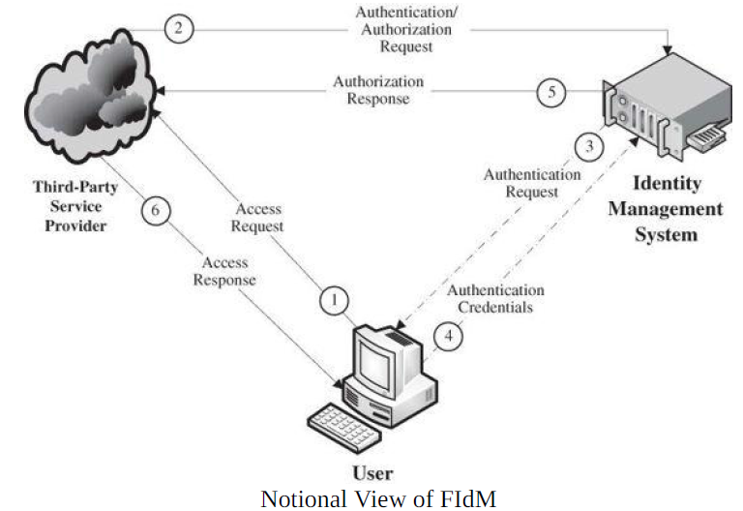
Cloud Identity Management

Slide 16
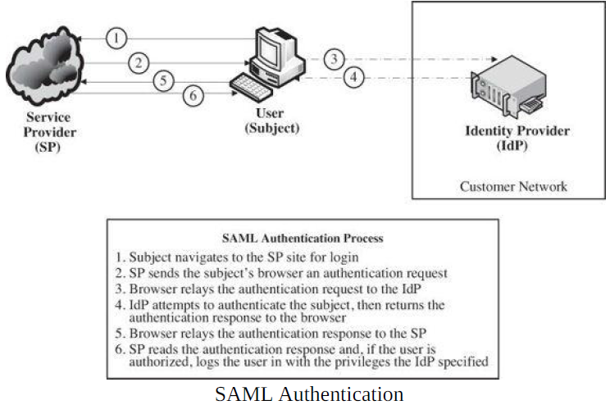
Security Assertion Markup Language

